Slide 1

“CHAT-DRIVEN E-COMMERCE EXPERIENCE”
Department of Computer Science and Engineering Interdisciplinary Project
PROJECT STUDENT
KATTA SYAMKUMAR
41110609
GUIDE
Ms. LAKSHMI PRIYA S, M.E, (Ph.D)

Slide 2
PRESENTATION OUTLINE
COURSE CERTIFICATION
OBJECTIVE OF THE PROPOSED WORK
LITERATURE SURVEY
MODULES
RESULT AND DISCUSSION
CONCLUSION
REFERENCES

Slide 3

COURSE CERTIFICATE

Slide 4
ABSTRACT
Online marketplace for agricultural products with Java-based chat box and MySQL database.
Aims to simplify agricultural trade by connecting farmers, distributors, and consumers.
Java chat box enables real-time communication, enhancing trust and transaction smoothness.
MySQL database efficiently manages product listings, user profiles, and transactions.
Design and implementation focus on improving accessibility and efficiency in agricultural trade.
Usability evaluation through user testing and feedback.
Chat box features include emoji reactions, message pinning, and group discussions.
Clear indicators for new messages and notifications keep users updated.
Comprehensive customer support provided through the chat box.
Access to price details enables informed decisions and transparent transactions.
Chatbot assists users in finding specific agricultural products based on their requirements.
Provides personalized recommendations to users based on their past interactions and preferences.
Offers guidance on best farming practices, crop management techniques, and market trends to farmers.

Slide 5
OBJECTIVE OF THE PROPOSED WORK
E-commerce encompasses purchasing goods and services online via the internet.
Four major types: Business-to-Business (B2B), Business-to-Consumer (B2C), Consumer-to-Consumer (C2C), Consumer-to-Business (C2B).
Communication process: browser communicates with the online store, order validation, notification of successful processing, order details sent to the warehouse.
Chatbot "Assist" facilitates seamless communication between farmers and shoppers.
Intuitive interface and natural language processing capabilities aid customers in finding products and answering farming queries.
Provides valuable insights into agricultural trends, empowering users with knowledge.
Aims to revolutionize agricultural trade by connecting farmers directly with consumers.
Eliminates the need for intermediaries, allowing farmers to set fair prices and maximize profits.
Offers personalized recommendations based on user preferences and past interactions
.Assists farmers in understanding market demand and adapting their produce accordingly.
Ensures a fair and prosperous future for farmers while meeting consumers' evolving needs in the digital age.

Slide 6
LITERATURE SURVEY
The application is developed using HTML, CSS, JAVA SCRIPT and SQL database. This is a simple e- commerce application developed for farmers to sell their products easier, and enabling buyers to purchase their products. We have not used any specific algorithm to develop this project. It all works in simple Java coding and connection to database. Registration of each category of user is saved in the database. As we add products into the store, it is stored in the database for the buyers to know the stock availability before purchasing the same. If the same is not available, they can contact the store and order
In the existing e-commerce portal to sell crops/fruits/vegetables, there is an intermediate vendor or multi-vendors through which the products are sold to us. Here, the vendor bargain with the farmers and get it at a very low cost and sell it to the customers at a high price, thereby earning profits, which in turn affects the farmers as they don’t even get the amount invested in the crops.
In this application, we have removed the need of intermediate vendors. That is, the farmers can directly sell their end products online to the customers. Since this application has a very simple UI, they won’t face much difficulties navigating through. In this way, it is ensured that farmers get the maximum profit. Moreover, by eliminating intermediaries, we empower farmers to establish direct connections with consumers, fostering transparency and fair pricing in the agricultural supply chain

Slide 7
PROPOSED SYSTEM
Elimination of intermediate vendors allows farmers to sell products directly to customers.
Simple UI ensures ease of navigation for farmers.
Direct sales increase profit margins for farmers.
Empowers farmers to establish direct connections with consumers.
Fosters transparency and fair pricing in the agricultural supply chain.
Encourages consumer trust in the origin and quality of products.
Reduces dependency on middlemen and their associated costs.
Enables farmers to have greater control over their sales and pricing strategies.
Facilitates feedback and communication between farmers and consumers.
Promotes sustainable agricultural practices by reducing carbon footprint associated with transportation and storage by eliminating intermediaries

Slide 8
SOFTWARE & HARDWARE REQUIREMENTS
HARDWARE :
Operating system : Windows 7 and 7+
RAM : 8 GB or more
Hard disc or SSD : More than 500 GB
Processor : Intel i3 or higher
SOFTWARE :
Software : HTML, CSS, PHP, JavaScript
Tool : Visual Studio, XAMPP & SQL

Slide 9
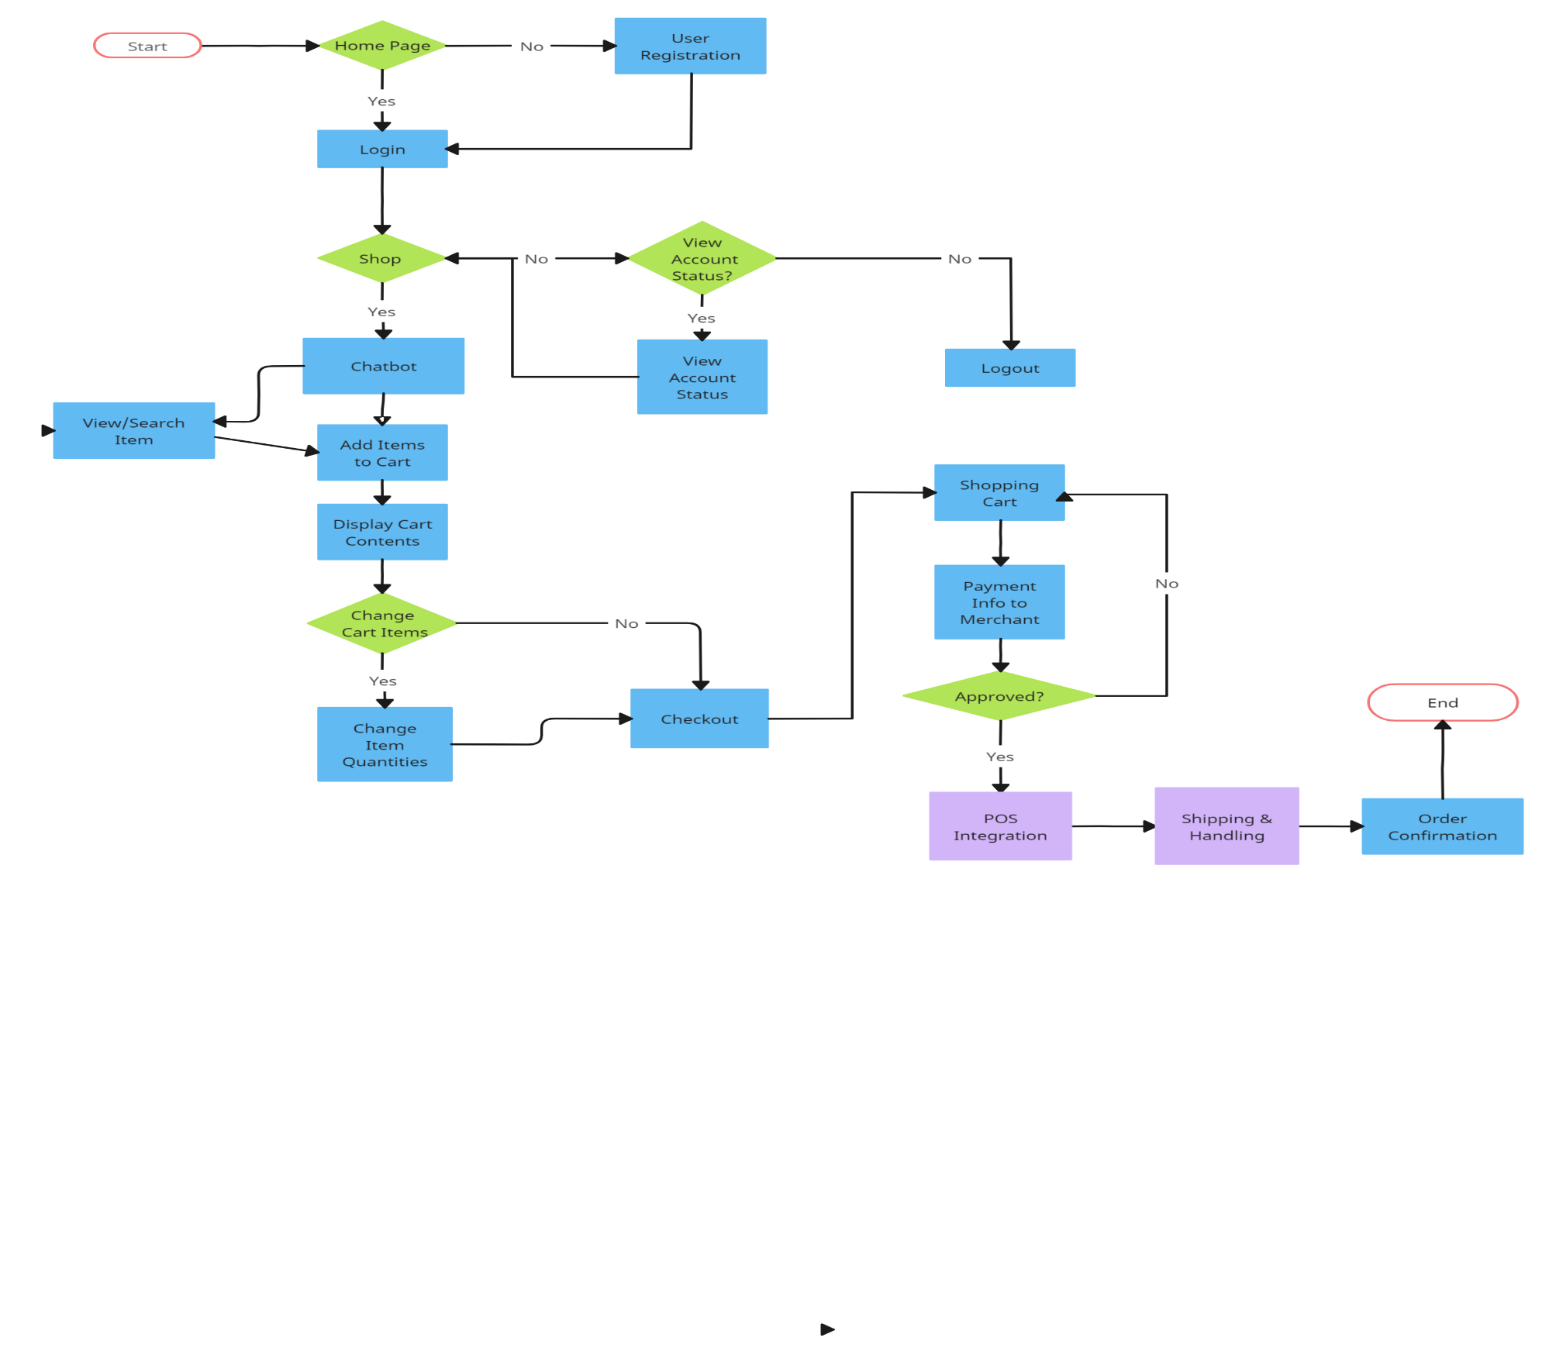
FLOW DIAGRAM

Slide 10
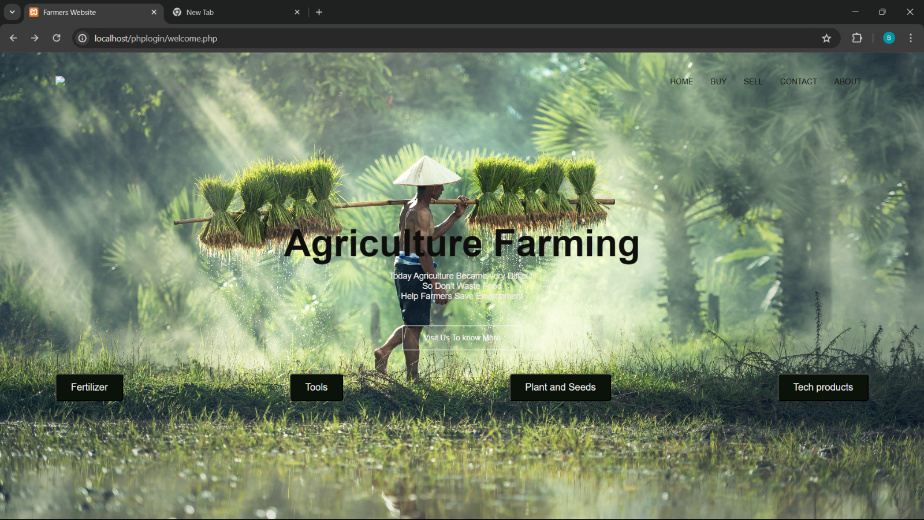
MODULES
Home Page
The homepage for agricultural supplies features clear navigation options leading to product categories like fertilizers, tools, seeds, and plants, with featured products and promotional banners for special offers. It includes search functionality and interactive elements for user guidance, along with customer reviews to build trust and credibility.

Slide 11
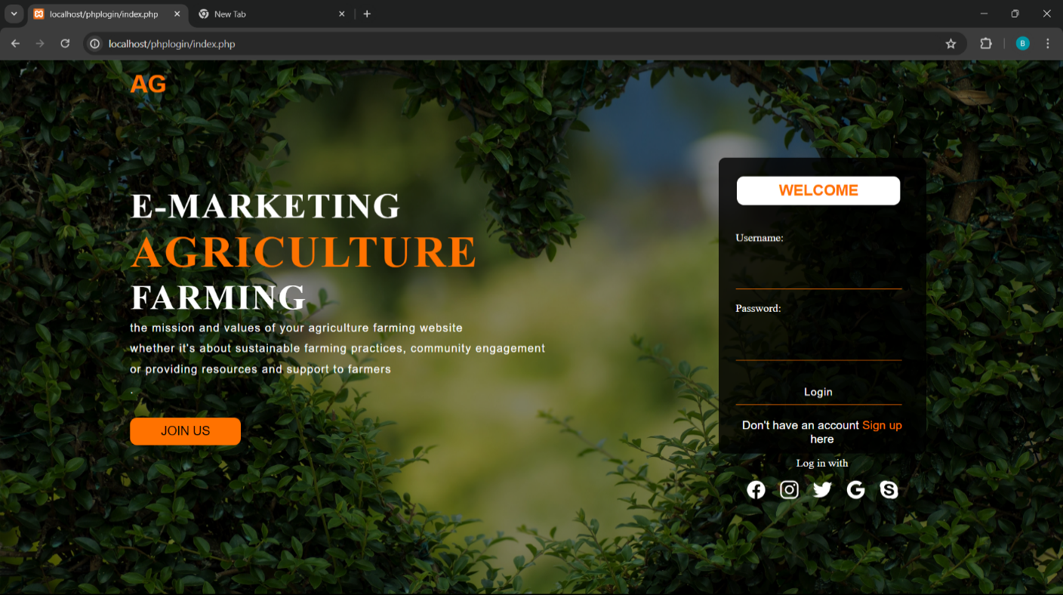
MODULES
Login Page
The eCommerce website features a "Seller" button leading to a secure login page where sellers input credentials to manage their listings and orders, with additional security measures like captcha or two-factor authentication for protection. Authenticated sellers access a personalized dashboard for efficient selling activities, ensuring a seamless and secure experience.

Slide 12
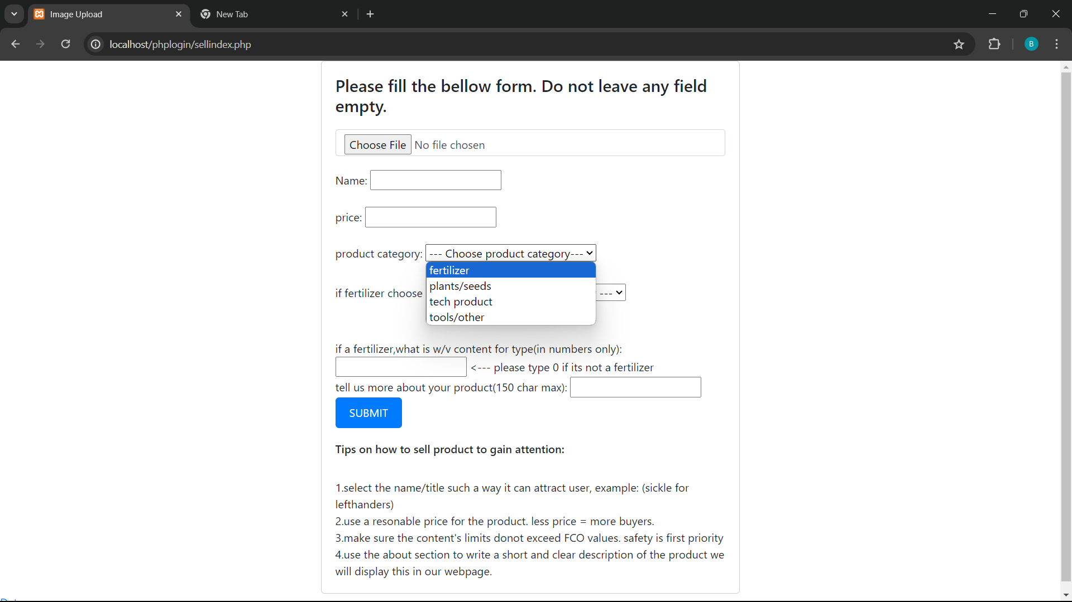
MODULES
Seller Form
Upon seller login, a form prompts input of product details like name, price, and category, with additional fields for specific product types like fertilizers, ensuring accurate categorization. Sellers efficiently manage listings through this organized form, enhancing product presentation on the eCommerce platform.

Slide 13
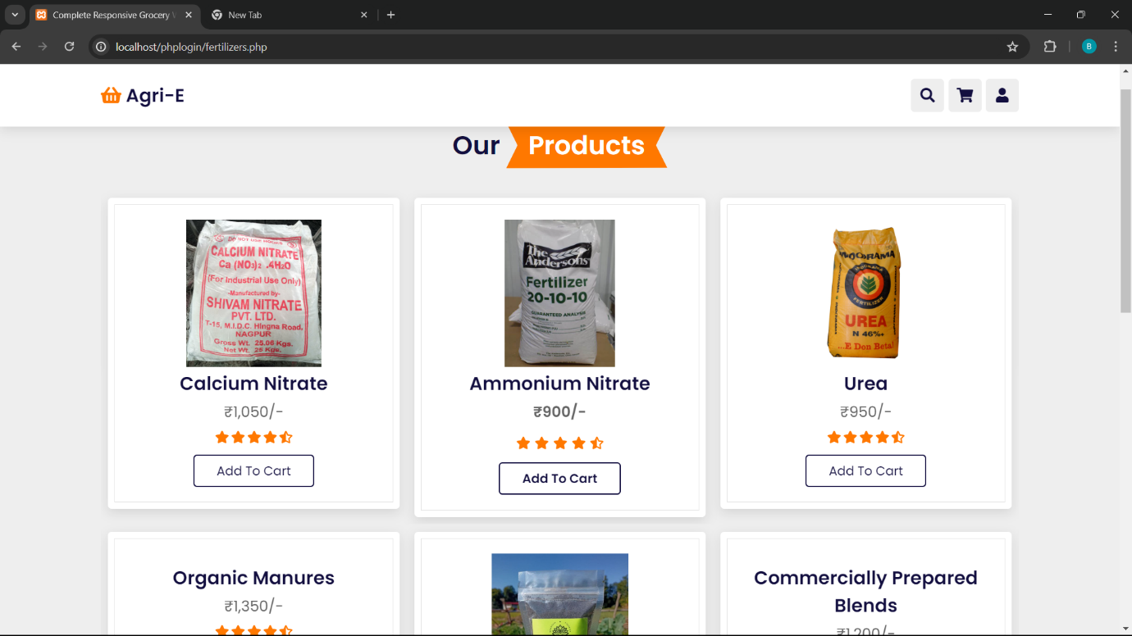
MODULES
Products Page
Customers browse and purchase products on the product listing page, featuring "Add to Cart" functionality, transparent pricing, and a search function for easy product discovery, enhancing the shopping experience. These features create a user-friendly environment for seamless product exploration, selection, and purchase.

Slide 14
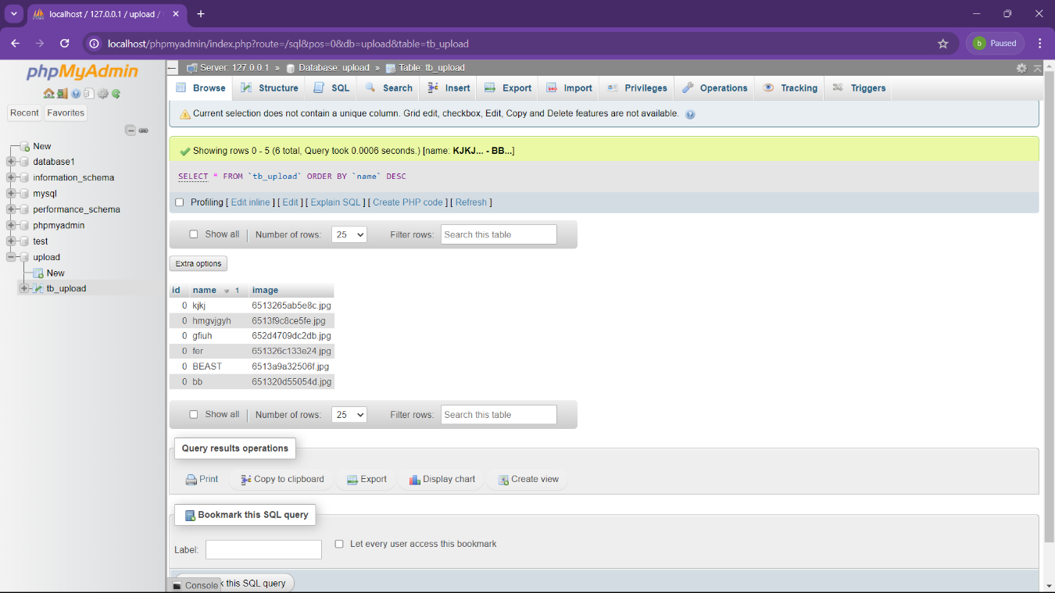
MODULES
SQL Database
Seller-entered data like product information, pricing, and categories are stored in MySQL databases, ensuring efficient organization and retrieval for seamless website operations. MySQL's robust features and scalability enable secure management of vast amounts of seller data, optimizing performance and maintaining system responsiveness.

Slide 15

MODULES
Chatbot
The agriculture eCommerce website's chatbot assists farmers by greeting them, providing product guidance, personalized recommendations, and support services, enhancing productivity and user experience through continuous learning and improvement.

Slide 16
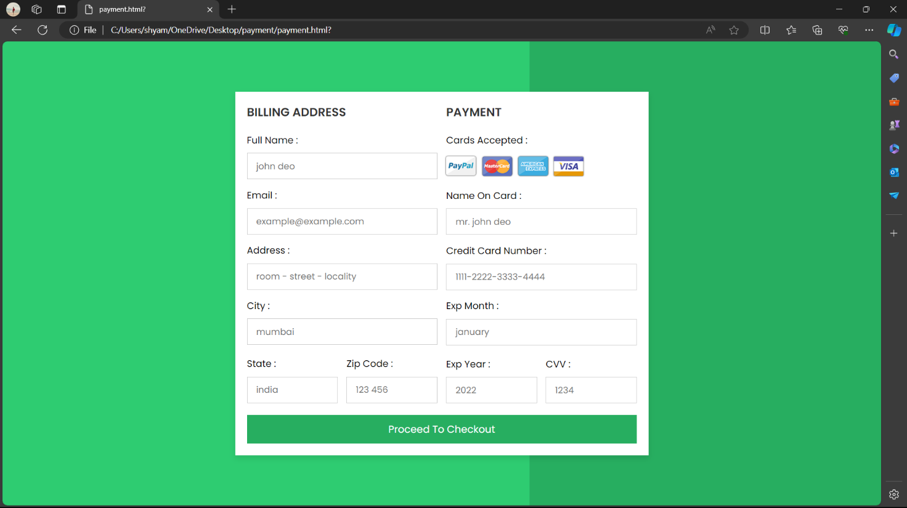
MODULES
Address/Payment
The eCommerce website's payment page offers various secure payment options and employs robust security measures, ensuring a seamless checkout experience with confidence and peace of mind for users.

Slide 17
RESULT AND DISCUSSION
Interactive Chatbot connected to an Agricultural website.
Facilitates communication between farmers and agricultural experts.
Easy access for farmers with minimal technical knowledge.
Eliminates involvement of third parties and middlemen.
Enables online product posting and selling for farmers.
Provides personalized advice from agricultural experts via chatbot.
Helps farmers with issues like soil quality, pests, and disease control.
Enhances customer service and builds stronger farmer-client relationships.
Displays location of nearest soil testing labs.
Offers crop recommendations based on soil type.
Provides information about government schemes for farmers.
Lists Direct Purchase Centers for agricultural products.
Offers Open Weather Forecast with real-time updates.
Helps in decision-making for planting, harvesting, and other activities.

Slide 18
CONCLUSION
E-commerce enables farmers to profit from their hard work.
Improves farming in rural societies by increasing awareness of crops and market prices.
Provides valuable crop information for government agencies.
Predicted to creatively control and enhance market access for smallholders.
Development of a user-friendly system accessible to rural farmers.
Aims to maximize earnings for farmers by bypassing wholesalers.
Incorporates unique technologies, advanced software solutions, and network reforms.
Strives for a better future for farmers through technology.
Future development includes payment integration, order tracking, and UI improvements.

Slide 19
REFERENCES
A Survey Conducted on E-Agriculture with Indian Farmers” by SumithaThankachan, Dr.S.Kirubakaran in International Journal of Computer Science and Mobile Computing on 2 February 2014.
“A study of Segments Contribution: E-commerce growth in India” by Mahipal.D in Academy of marketing Studies Journal in 2018.
“E-Commerce in agri-food sector: a systematic literature review” by Yiwu Zeng, Fu Jia, Lia Wan and HongdongGuo in the International Food and Agriculture Management Review on 26 February 2017.
“Emerging Trends of E-Commerce in India: An Empirical Study” by Shetter.M in International Journal of Business and Management Invention in 2016.
Namisko and Moses Aballo “Current status of agriculture and Global Trends” in International Journal of Science and Research Volume 2 Issue 7,2013.
“Understanding E-Commerce: A study with reference to competitive economy” by Neha Wadhawan and RK Arya in Journal of Critical Reviews on 25 June 2020

Slide 20

THANK YOU

